Slide 1
Sharif Digital Flow Introduction Part I : Synthesize & Power Analyze
Nemat Allah Ahmadyan
Dependable System Lab [DSL], CE Department
Sharif University of technology
2009

Slide 2
Introduction
The following presentation is based on
Version 1.213
Mentor ModelSim 6.5 SE
Synopsys Design Compiler 2007
Cadence SoC Encounter 8.1
Synopsys HSIM 2007
Synopsys PrimePower 2003
Synopsys PrimeTime 2003

Slide 3
© before we begin
Part of these slides are extracted from the following copyrighted materials:
Synopsys DesignCompiler, PowerCompiler & PrimePower Reference Manual & User guide
ASIC Design Flow Slides, prepared by Frank Gurkayanak
From Integrated Systems Labratoary, EPFL
Cadence SoC Encounter Synthesis Place-and-route flow guide
Synopsys HSIM reference manual.

Slide 4
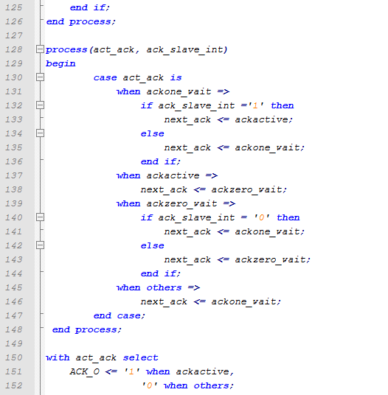
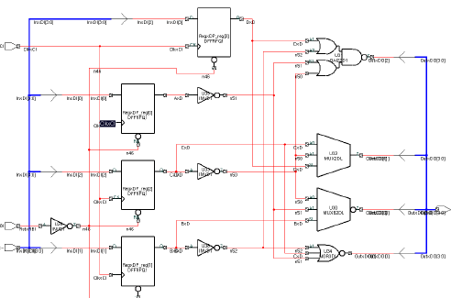
Synthesis
Process of converting verified HDL code to hardware

Slide 5
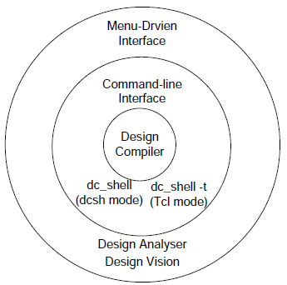
Synthesize
The process of mapping RTL netlist into Gate-level netlist
We recommends Synopsys Design Compiler.
Environment setup for Design Compiler
% setenv SYNOPSYS /opt/synopsys/Z-2007.05-sp3
% setenv LM_LICENSE_FILE /opt/licenses/license.dat
% set path = ($SYNOPSYS/linux/syn/bin $path)
Starting DC:
dc_shell & dc_shell-t (TCL)
design_vision

Slide 6
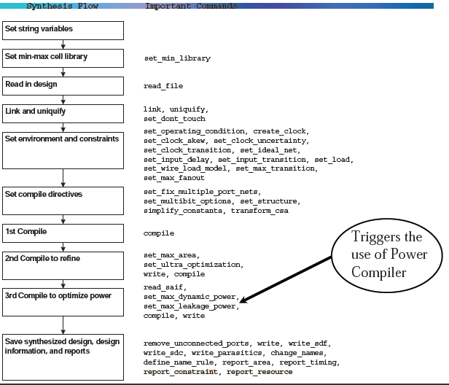

Slide 7
Defining Variables
Variables includes:
Libraries (min/max)
Cache
Design
constraints

Slide 8
Reading libraries
Libraries Usually will be provided in Liberty format (.lib)
Read them using read_lib
Then produce synopsys db file using write_lib command.
ReRead the library db file to synopsys.

Slide 9
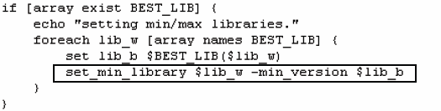
Reading Libraries
For one process, we may have many timing libraries, usually, best, typical & worst.
dc_shell> set_min_library worst.db –min_version best.db
For simplicity, we recommends:
dc_shell> set link_library [set target_library [concat [list lib.db] [list dw_foundation.sldb]]]
dc_shell> set target_library “lib.db“
dc_shell> define_design_lib WORK -path ./WORK

Slide 10
Reading Design, link & uniq
Link
Resolve the design reference based on reference names
Locate all design and library components, and connect them
Uniquify
Removes multiply-instantiated hierarchyin the current design by creating a unique design for each cell instance
dc_shell> analyze -f verilog $my_verilog_files
dc_shell> elaborate $my_toplevel
dc_shell> current_design $my_toplevel
dc_shell> link
dc_shell> uniquify

Slide 11
Operating Condition
Setting Min/Max operating condition (only if you’ve min/max libraries)
dc_shell> Set_operating_conditions –max “slow” –min “fast”
dc_shell> Set_operating_condition –max “slow”

Slide 12
Design Constraints
Design Objectives
Speed
Area (default)
Power (requires Power Compiler license )
When both area and delay constraints are set, design compiler will give speed priority.

Slide 13
Constraining the Design
The synthesizer is ”lazy”, if you don’t set the proper constraints it will select constraints that will make him work less.
Always set proper constraints
Timing Constraint
Max delay combinational delay
Max area total circuit area
Max power for power limitation
Setting the constraint does not guarantee the result

Slide 14
Constraint for Area
By default, timing constraints have higher priority over area constraint.
“-ignore_tns” -> give area priority over timing.
area constraint can be set using the “set_max_area” command: dc_shell> set_max_area 100

Slide 15
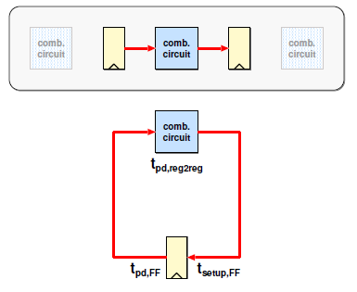
Sequential Timing
Timing Paths
Register to register

Slide 16
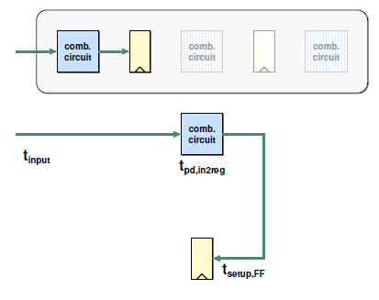
Sequential Timing
Timing Paths
Register to register
Input to register

Slide 17
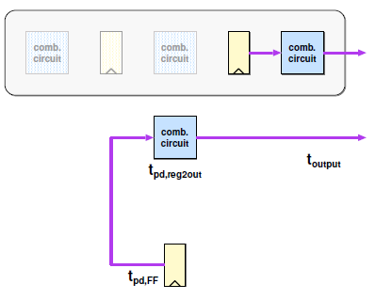
Sequential Timing
Timing Paths
Register to register
Input to register
Register to output

Slide 18
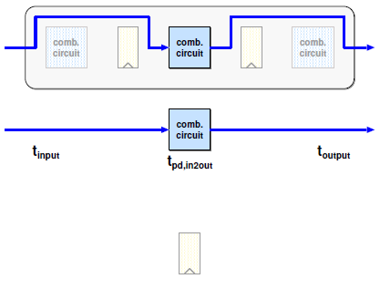
Sequential Timing
Timing Paths
Register to register
Input to register
Register to output
Input to output
One of these paths will limit the performance of the system.

Slide 19
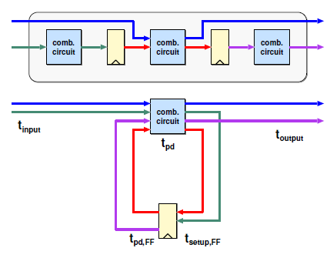
Sequential Timing
Timing Paths
Register to register
Input to register
Register to output
Input to output
One of these paths will limit the performance of the system.

Slide 20
Constrain for Speed
Always have a “Time Budget”
With the simplified timing assumption:
dc_shell> create_clock “CLK” –period T –waveform { T/2 T } –name cn
Delay of input signals (Clock-to-Q, Package etc.) dc_shell> set_input_delay 0 –clock cn all_outputs() – CLK
Don’t forget! Remove_input_delay [get_ports CLK]
Reserved time for output signals (Holdtime etc.) dc_shell> set_output_delay 0 –clock cn all_outputs()
SDC file (write_sdc)
Later STA & P&R tools need these constraints
Virtual Clock (for combinational circuit)

Slide 21
Constraint for speed
Set_max_delay
Specifies the desired maximum delay for paths in the current design.
dc_shell> set_max_delay 15.0 -from {ff1a ff1b} -through {u1} -to {ff2e}
dc_shell> set_max_delay 8.0 -from {ff1/CP} -rise_through {U1/Z U2/Z} - fall_through {U3/Z U4/C} -to {ff2/D}
set_min_delay
sets the minimum delay target for paths in the current design
dc_shell> set_min_delay 3.0 -from ff1/CP -rise_through {U1/Z U2/Z} -fall_through {U3/Z U4/C} -to ff2/D

Slide 22
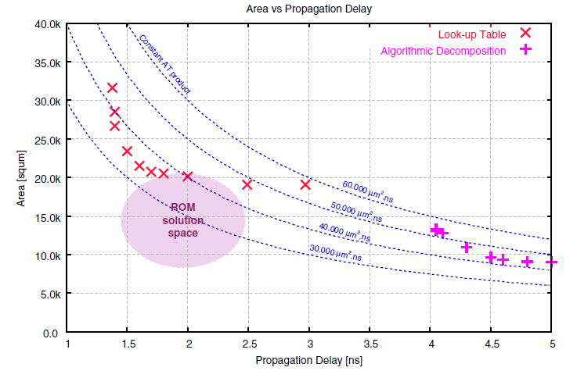
Different constraints, different circuits

Slide 23
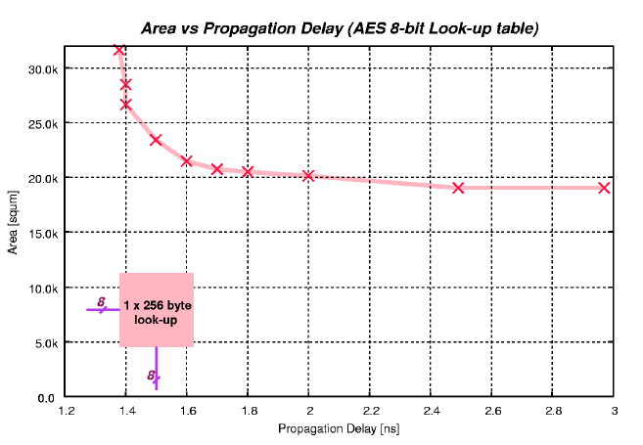
Don’t trust the synthesizer too much

Slide 24
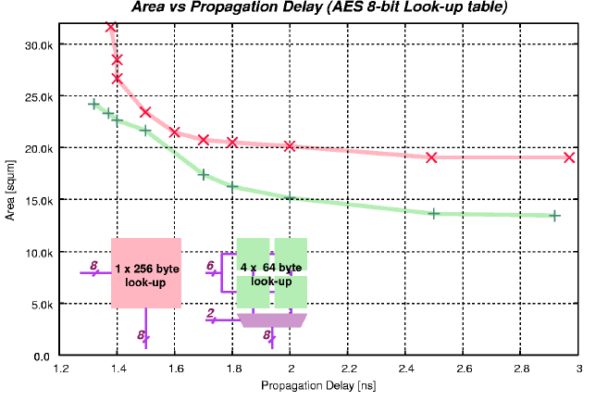
Don’t trust the synthesizer too much

Slide 25
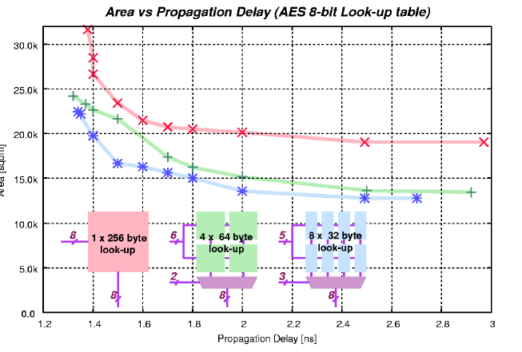
Don’t trust the synthesizer too much

Slide 26
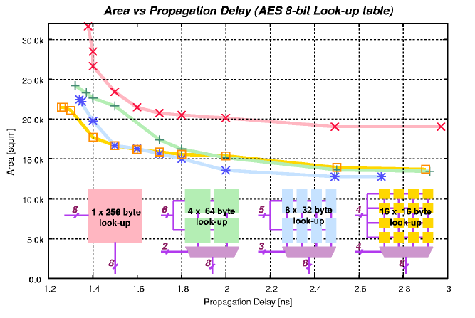
Don’t trust the synthesizer too much

Slide 27
Timing Exceptions
Static timing analysis assumes all data transfer within one clock cycle.
By default, all timing paths are measured using the same rule.
Any exception to the above are referred to as timing exception. The following are commands to set timing exceptions:
set_false_path
set_multicycle_path
set_max_delay
set_min_delay
Timing exceptions are identified by designers only. It is not possible to identify timing exceptions automatically using tools.

Slide 28
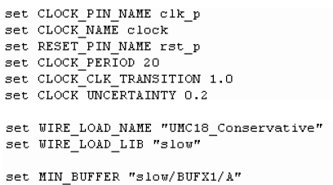
Clock
Create_clock
Set_clock_skew
Set_clock_uncertainty
Set_clock_transition

Slide 29
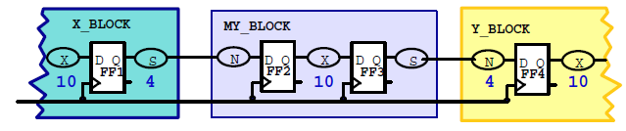
Time Budget
You’re not alone in the design!
For a 100 MHz Clock, block N used 40% of clock period.
Better to budget conservatively than to compile with paths unconstrained.

Slide 30
Gated Clock
Gated clocks can be specified at the root of the clock port.
By default, design compiler will assume ideal clock and take the gating logic as zero delay elements.
Derived clocks must be specified at the outputs of sequential elements: dc_shell> create_clock {ClkRoot} –p 8 –name “croot” dc_shell> create_clock {clkgen/Q1 clkgen/Q2}-p 16 –name “croot_by_2”

Slide 31
Compiling
Usually, we have to perform 2 or 3 compile
1st compilation Rough compilation (timing only)
dc_shell> compile –map_effort medium
2nd compilation Refine circuit area and timing
dc_shell> add some constraints
dc_shell> set_ultra_optimization true
dc_shell> set_ultra_optimization -force
dc_shell> compile –map_effort high –incremental_map
3rd compilation Optimize power

Slide 32
Synopsys power compiler
Optimize for Power with

Slide 33
Power Compiler
Power Compiler always works within the Design Compiler shell and is transparent to Design Compiler users.
Synopsys Power Optimizations “tricks”
gating clocks of register banks
operand isolation.

Slide 34
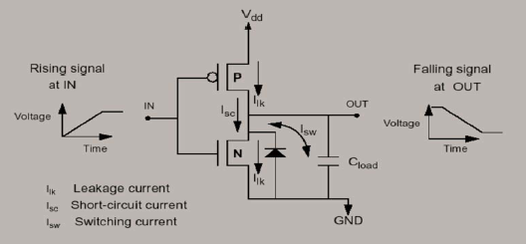
Power Components
Leakage
Dynamic
Switching
Internal

Slide 35
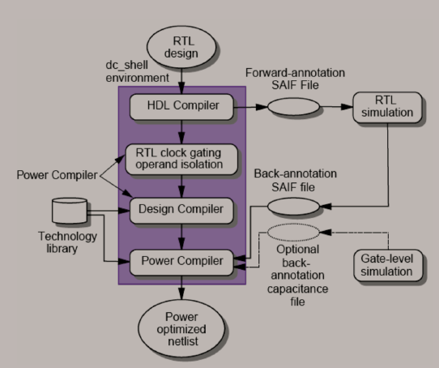
Power Compiler flow

Slide 36
Switching activity
Back annotation file:
contains the resultant switching activity of the elements monitored during RTL simulation.
Annotate the switching activity on some or all design objects byusing the read_saif, annotate_activityor set_switching_activitycommands
Forward annotation file:
Containing directives that determine which design elements to trace during simulation.
The gate-level forward-annotation file is created by using the lib2saifcommand.
RTL forward annotation file is generated using rtl2saif command.
using information from the GTECH design created by HDL Compiler.
Synopsys HDL Compiler converts the design to a technology-independent format called a GTECH design

Slide 37
SAIF file
The forward-and back-annotation files are in Switching Activity Interchange Format (SAIF).
many simulators (including ModelSim) support the Value Change Dump (VCD) format.
Synopsys offers an interface between VCD and SAIF.
vcd2saif command
ModelSim VCD Command:
vsim> vcd file test.vcd
vsim> vcd add –r testbench/core/*

Slide 38
Activity Generation
Activity of the synthesis invariant nodes is captured during RTL simulation
primary inputs, sequential elements, black boxes, three-state devices, and hierarchical ports.
For more Accurate power estimation, dumping activity of all node is required.
Manually annotating activity
dc_shell> annotate_activity -static_probability 0.5 -toggle_rate 0.2 -period 20
dc_shell> annotate_activity -static_probability 0.5 -toggle_rate 2.0 -period 20 -objects clock

Slide 39
Switching Activity in ModelSim
We recomments USING VCD with ModelSim
vsim> vcd file test.vcd
vsim> vcd add –r testbench/core/*
However, it’s possible to generate SAIF file in modelsim
vsim –foreign “dpfli_init dpfli.so” test (or Use PLI )
Read_rtl_saif fwd.saif test/DUT
Set_toggle_region test/DUT
Toggle_start
Run -all
Toggle_stop
Toggle_report back.saif 1e-9 test/DUT

Slide 40
Constraints for Power
Triggers Power Compiler
Usually it’s like this:
First compile
read saif (backward)
set_max_dynamic_power
set_max_leakage_power
Compile, write

Slide 41
Power Compiler - Analyze
First, generate the forward saif & simulate the design in ModelSim. Then run the design compiler, after initial commands, loading libraries etc, use:
dc_shell> create_power_model -format vhdl -hdl_files {sm_seq.vhd sm.vhd} -top_design sm_seq
dc_shell> reset_switching_activity -all
Read the backward-saif
dc_shell> read_saif -input sm_back.saif -instance test_sm/dut -rtl_direct
dc_shell> report_activity > reports/report_activity_5.rpt
dc_shell> report_rtl_power > reports/report_rtl_power_5.rpt

Slide 42
Power Compiler - Compile
Must specify switching activity
Invokes Power Compiler
dc_shell> reset_switching_activity -all
dc_shell> read_saif –input test.saif –instance testbench/core –rtl_direct
dc_shell> report_power
Setting Constraints & Compile
dc_shell> set_max_dynamic_power 450 uW
dc_shell> set_max_leakage_power 200 nW
dc_shell> compile –map_effort high –incremental_map -verify_effort medium
Final reports
dc_shell> report_saif -hier -missing -rtl > reports/report_saif_6_1.rpt
dc_shell> report_power -hier -verbose -analysis_effort medium -net -cell -sort_mode name > reports/report_power_6_1.rpt

Slide 43
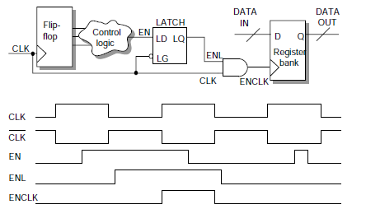
Power Compiler – Clock Gating
Example: Latch-based clock gating
Reduced Net Switching
Reduced internal leakage

Slide 44
Clock Gating user control
Integrated or non-integrated gating cell
Latch based or latch –free
Logic to increase testability
Minimum nr of bits to trigger clock gating
Explicitly include/exclude signals
Max fanout for each gating element
Rewire clock-gated register to another clock gating cell
Resize clock-gating element

Slide 45
Clock Gating Command
set_clock_gating_style
[-sequential_celllatch | none]
[-minimum_bitwidthminimum_bitwidth_value]
[-setupsetup_value]
[-holdhold_value]
[-positive_edge_logic{ gate_list | integrated}]
[-negative_edge_logic{ gate_list | integrated}]
[-control_pointnone | before | after]
[-control_signalscan_enable | test_mode]
[-observation_pointtrue | false]
[-observation_logic_depthdepth_value]
[-max_fanoutmax_fanout_count]
[-no_sharing]

Slide 46
Power Compiler – Clock Gating
Enabled by
dc_shell> set_clock_gating_style -pos {inv nor buf} -neg {inv and inv}
dc_shell> elaborate sm_seq -gate_clock
Reports:
dc_shell> report_clock_gating > reports/report_clock_gating_11.rpt
dc_shell> set_clock_skew ideal CLK
dc_shell> propagate_constraints -gate_clock
Then compile

Slide 47
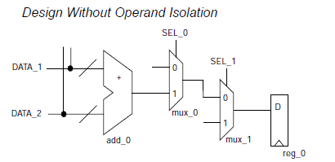
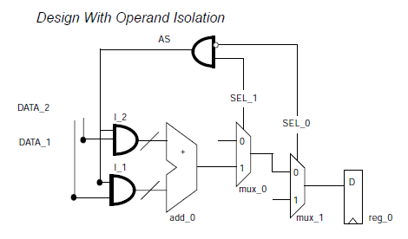
Power Compiler – Operand Isolation
Problem
Operands change inducing switching even when the output is being ignored
Solution
Isolate operands using the control signal

Slide 48
Operand Isolation
Pragma Isolation Method ( in HDL code )
if ( c1=‘1’) then
o <= temp + b ; -- synopsys isolate_operands
else
o <= g ;
end if ;
Based on Synopsys Gtech Isolation Method
DC Script:
set_operand_isolation_cell {FSM/DW02_MULT}

Slide 49
Power Compiler – Operand Isolation
Enable it by:
dc_shell> do_operand_isolation = true
dc_shell> set_operand_isolation_style -logic AND
dc_shell> set_operand_isolation_cell {FSM/DW02_MULT}
dc_shell> set_operand_isolation_slack 2
Then Compile
Reports
dc_shell> report_operand_isolation > reports/operand_isolation_12.rpt

Slide 50
Synthesize with StYLe!
Use scripts
Automatic
Press and run
No user interaction required
Less error prone
Avoids user’s mistake during operating GUI interface
Reusable
Synthesis script can be easily modified for different projects
Be procedural
Suggestion: build your scripts with make
Suggestion: organize your scripts
Compile.tcl
Constraints.tcl
Util.tcl …

Slide 51
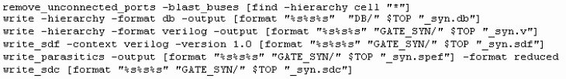
Save your work!
Remove unconnected ports before saving the synthesis design
Save synthesized design and info
XXX_syn.db SynopsysDB file
XXX_syn.v Verilog gate-level netlist
XXX_syn.sdf back annotated time info for gate-level netlist
XXX_syn.spef parasitic info (RC) of the gate-level netlist

Slide 52
Important Notes
Analyze package files (if any exists) before elaboration
Current design is one of the elaborated ones.
Note files’order when using analyzecommand
Use reset_switching_activitycommand before read_saifcommand
Use check_design–post_layoutto understand current design errors and warnings
Annotate switching activity before and after each compile

Slide 53
Important Notes
You are notallowed to use –rtl_directoption for read_saif command in dc_shell
Do notuse generate loops during back SAIF file generation using file DPFLI.
Different reports generated by Synopsys Design Compiler:
report_clock
report_bus
report_references
report_net
report_cell
report_timing –delay min/max –max_path
report_constraint –all_violators
report_resources
….

Slide 54
Synthesis Results
Synthesis is just a tool
Synthesis tools do not magically generate circuits
They are supposed to generate exactly the circuit that you want
You must have a good idea of what the synthesis result will be
If the result is not as you expect, you should convince the synthesizer to produce the correct result.

Slide 55
Back-end design
Part I: Placement & Routing

Slide 56
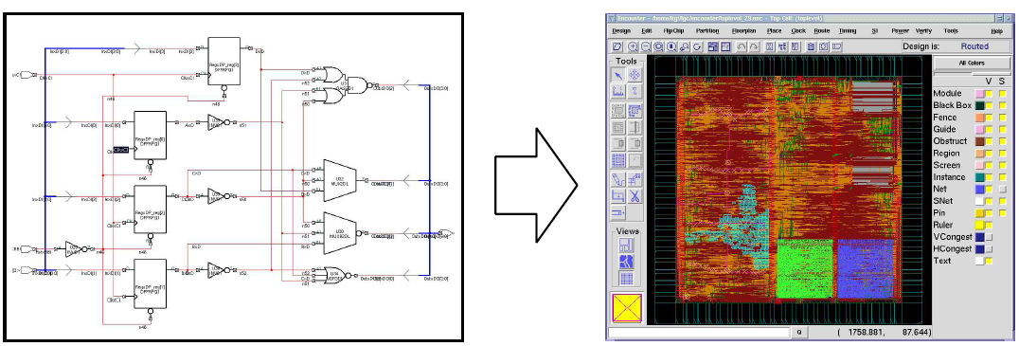
P&R
Converting netlist or design to physical layout.

Slide 57
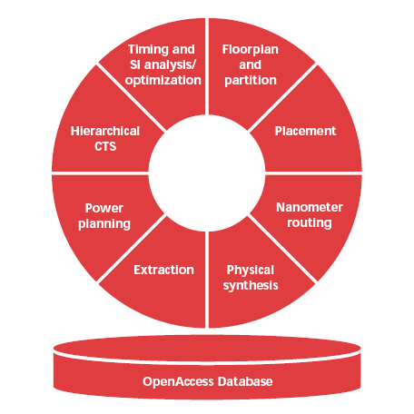
SoC Encounter
We use Cadence SoC Encounter 8.1 for Layout.
SOCE is a platform and integrates
First Encounter Ultra
CeltIC
NanoRoute
SignalStorm NDC
VoltageStorm
Fire& Ice QXC

Slide 58
Design flow
User data
Import data
*CTS synthesis
SVP
Floorplan
Timing analysis
Route
power analysis
powerplan
Stramout
placement
*.gds
*.DEF
Timing Optimization

Slide 59
Required data
Library
Physical Library(*.LEF)
Timing Library(*.LIB)
Capacitance Table
Celtic Library
Fire&Ice/VoltageStorm Library
User Data
Gate-Level netlist(*.v)
Timing constraints(*.sdc)
IO constraint(*.ioc)

Slide 60
Initial GUI

Slide 61
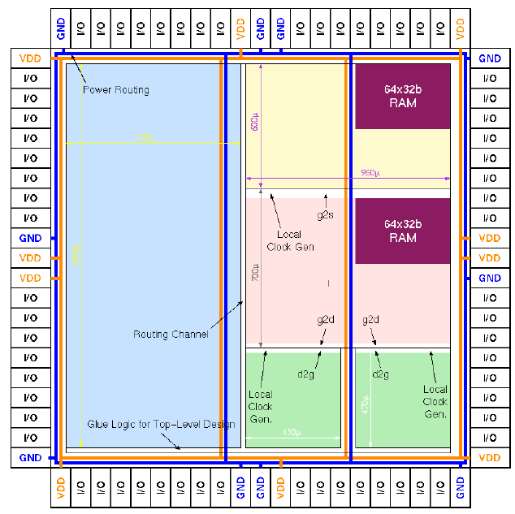
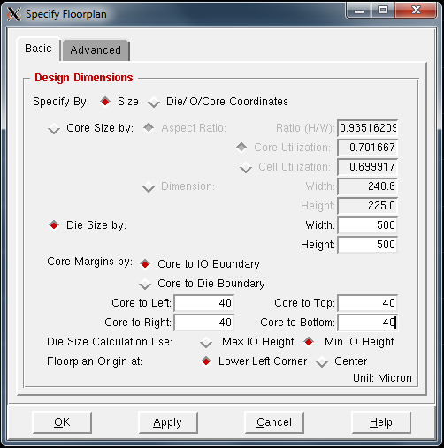
FloorPlanning
Determine the total area/geometry of the chip
Place the I/O cells Place pre-designed macro blocks
Leave room for routing, optimizations, power Connections
Remember to put some place for glue logic of top-level design

Slide 62
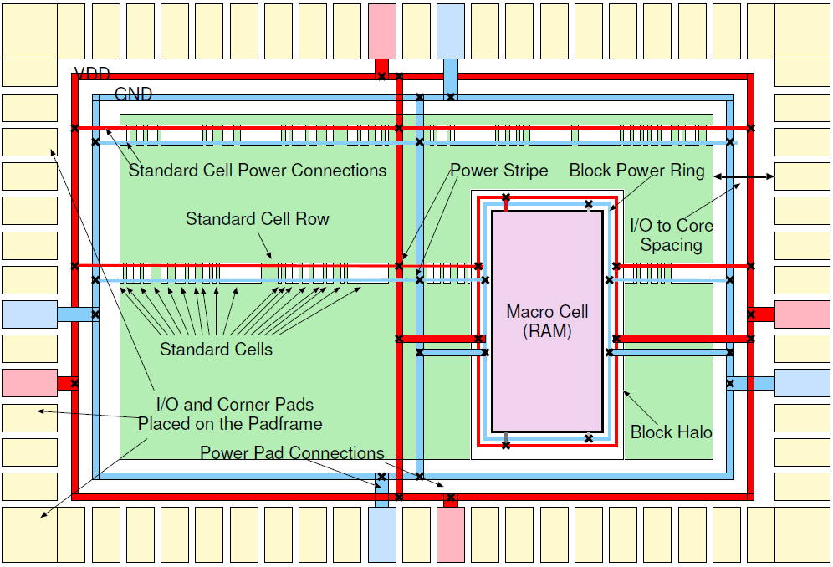
Power Planning
Add Rings, Stripes & do a special route (SROUTE)

Slide 63
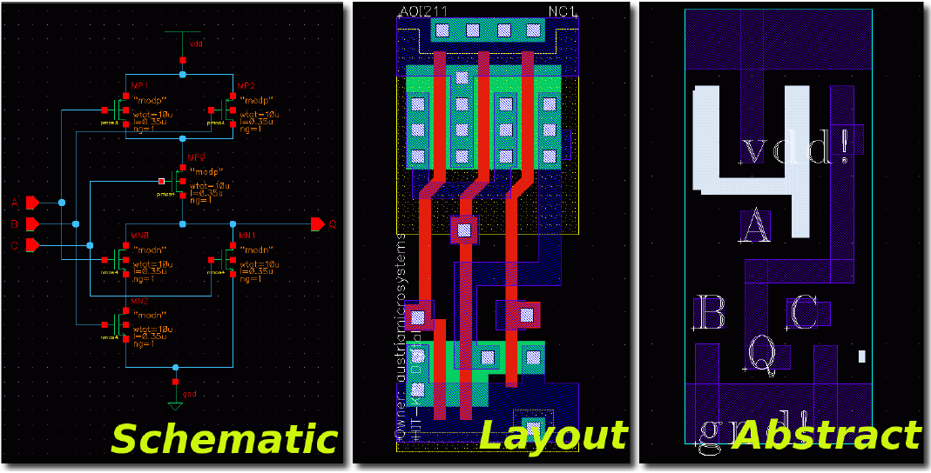
Standard cells

Slide 64
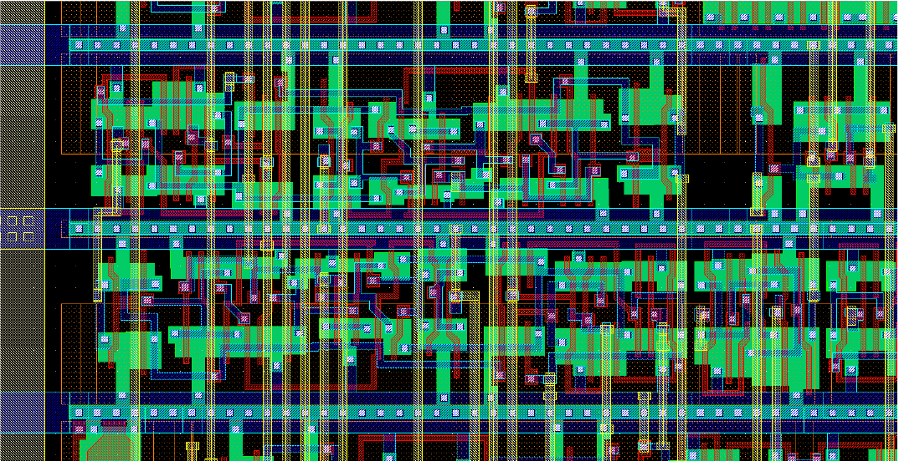
Standard cell rows

Slide 65
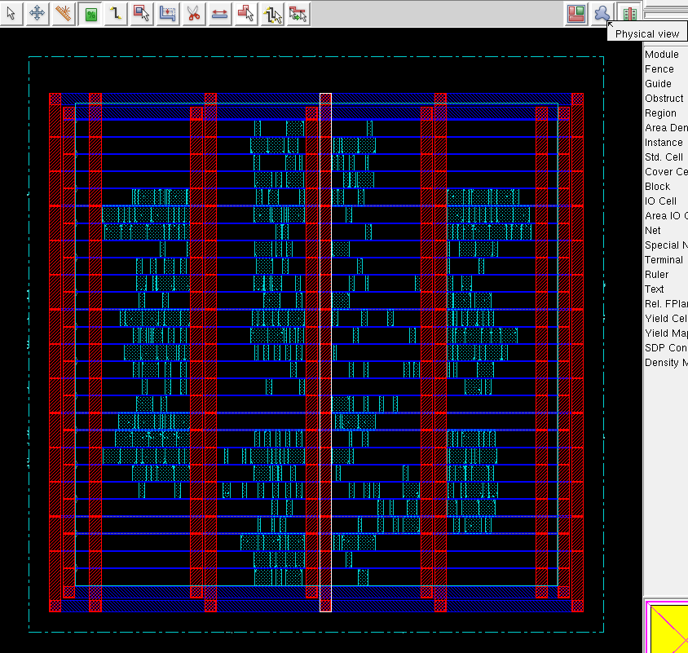
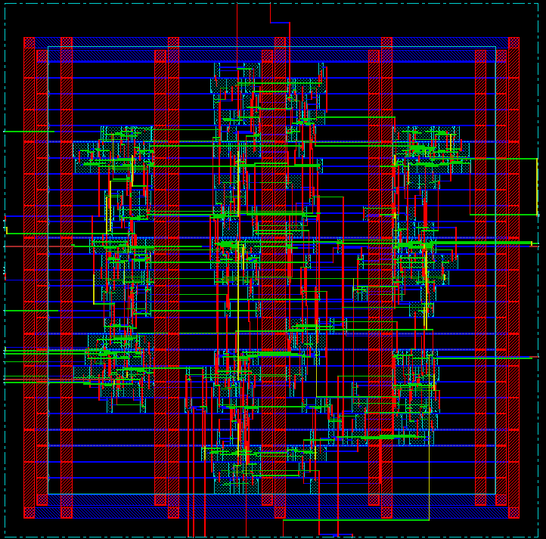
Placement & Routing

Slide 66
Placement
NP hard problem
What is the best way of placing the cells within a given area so that:
Critical path is minimum
Long interconnections on the critical path add capacitance
The design is routable
Not all placements can be routed.
The area is minimum
The routing overhead inreases area.

Slide 67
Clock Tree Synthesis
Clock->Create Clock Tree Spec…
Clock->Specify Clock Tree…

Slide 68
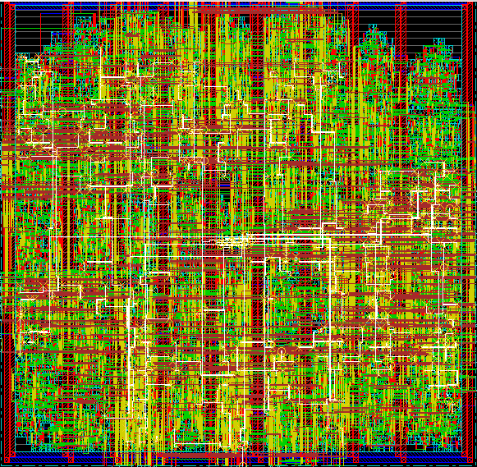
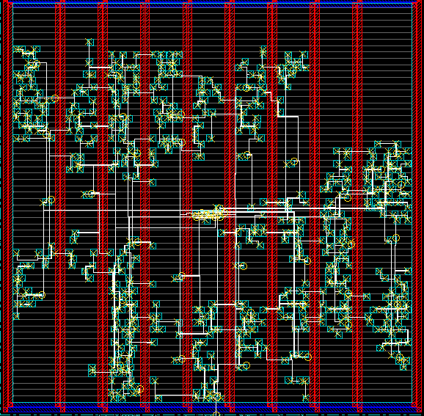
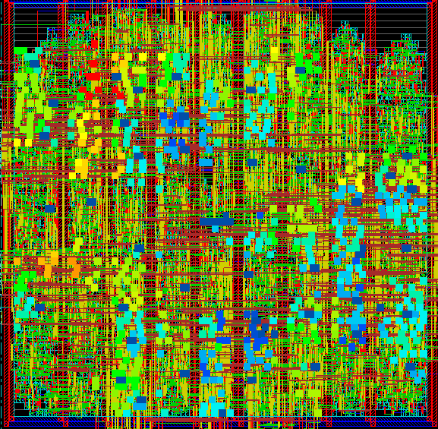
Clock tree synthesize
Total FF: 527
Total SubTree: 50
Max Level: 3
TREE->
CLKBUF2
(8)CLKBUF1
(5) CLKBUF3
(13) DFFPOS

Slide 69
Clock Distribution
Clock is the most critical signal
Standard digital systems rely on the clock signal being present everywhere on the chip at the same time: skew
Clock signal has to be connected to all flip-flops: high fan out
Specialized tools insert multi level buffers (to drive the load) and balance the timing by ensuring the same wirelength for all connection.

Slide 70
Clock Distribution example
The following example is a 200 MHz 3D image renderer with roughly 3 million transistors. The clock distribution has:
10.928 flip-flops
9 level clock tree
478 buffers in the clock tree
34 cm total clock wiring
This clock-tree is based on H-Tree

Slide 71
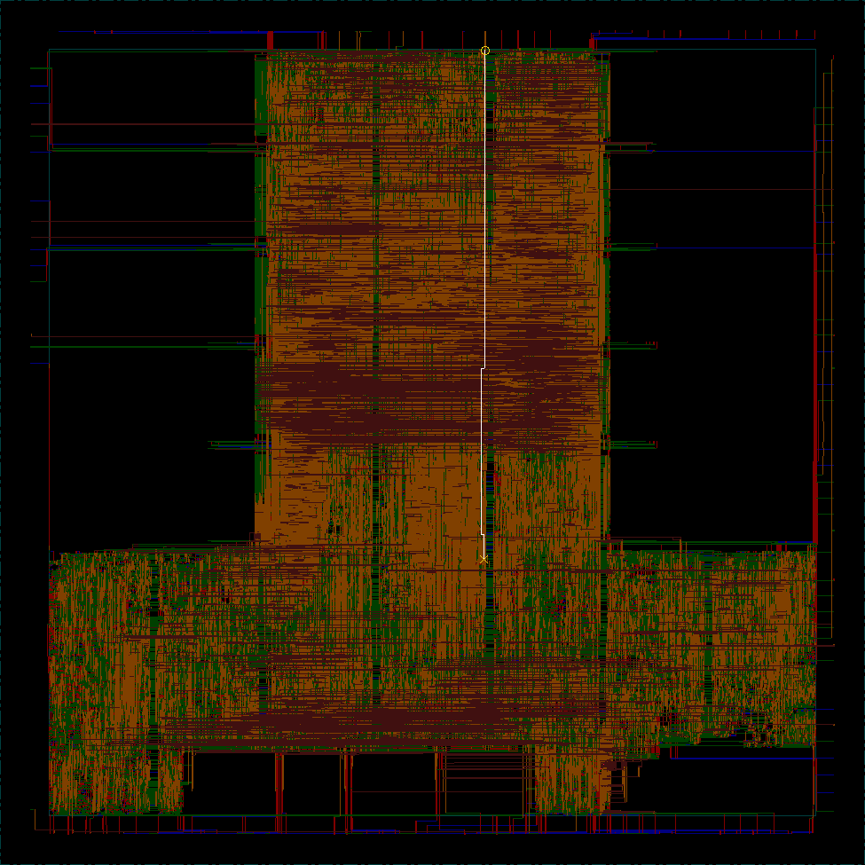

Slide 72


Slide 73
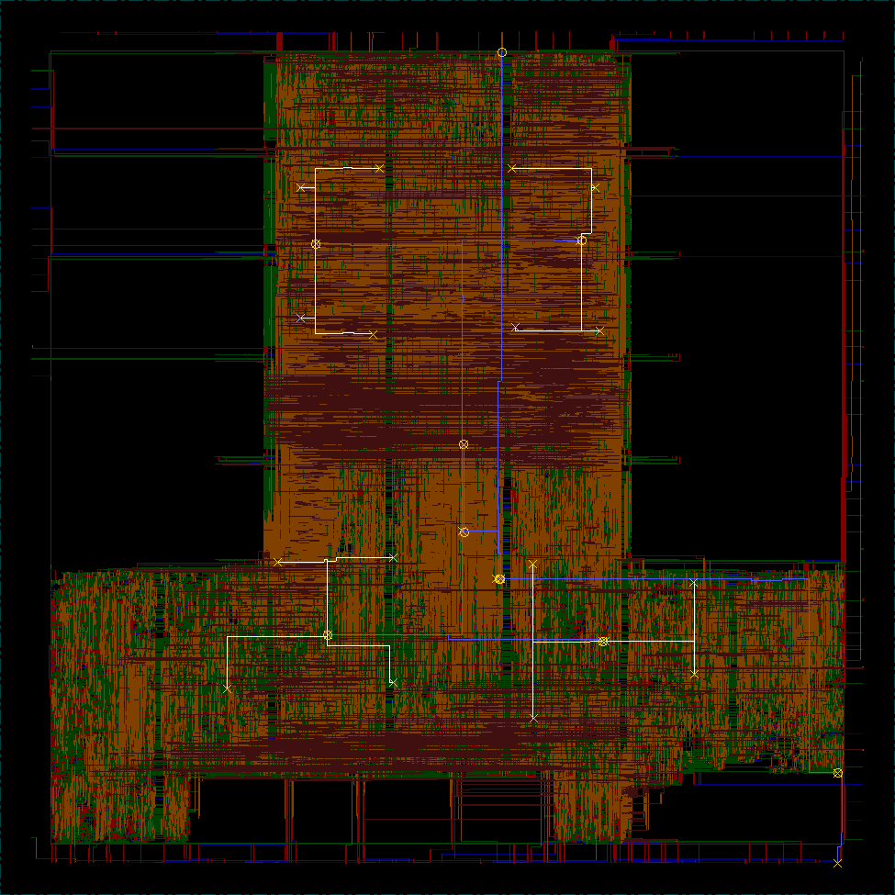

Slide 74


Slide 75
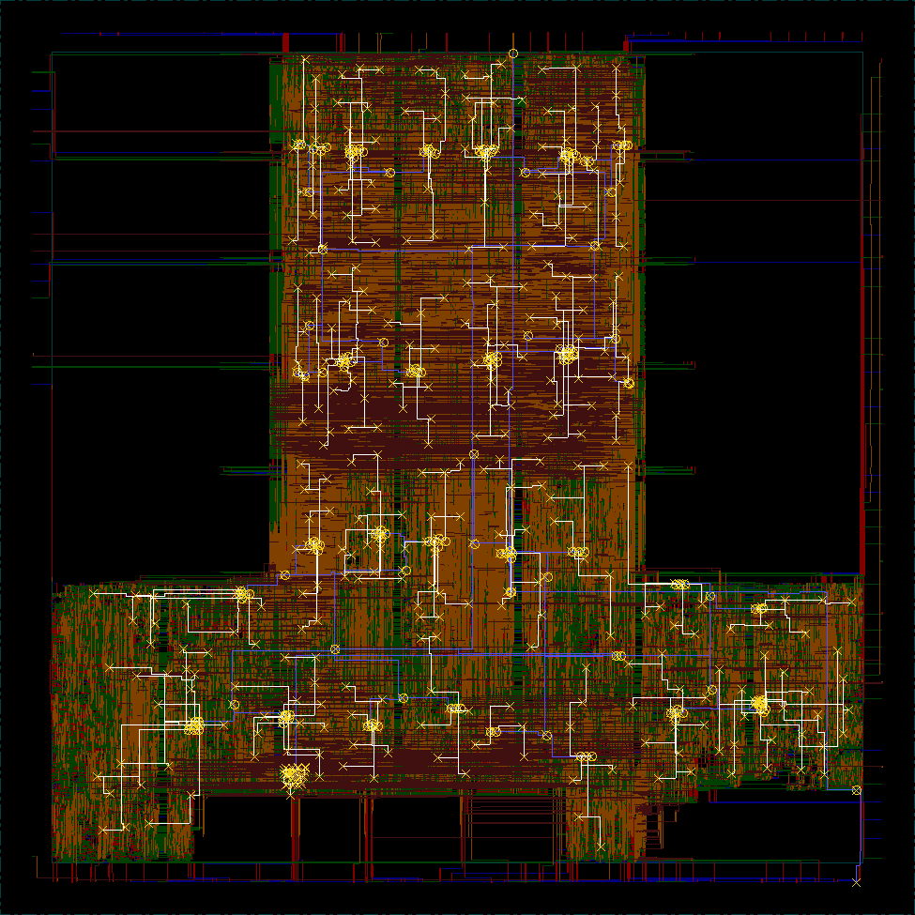

Slide 76
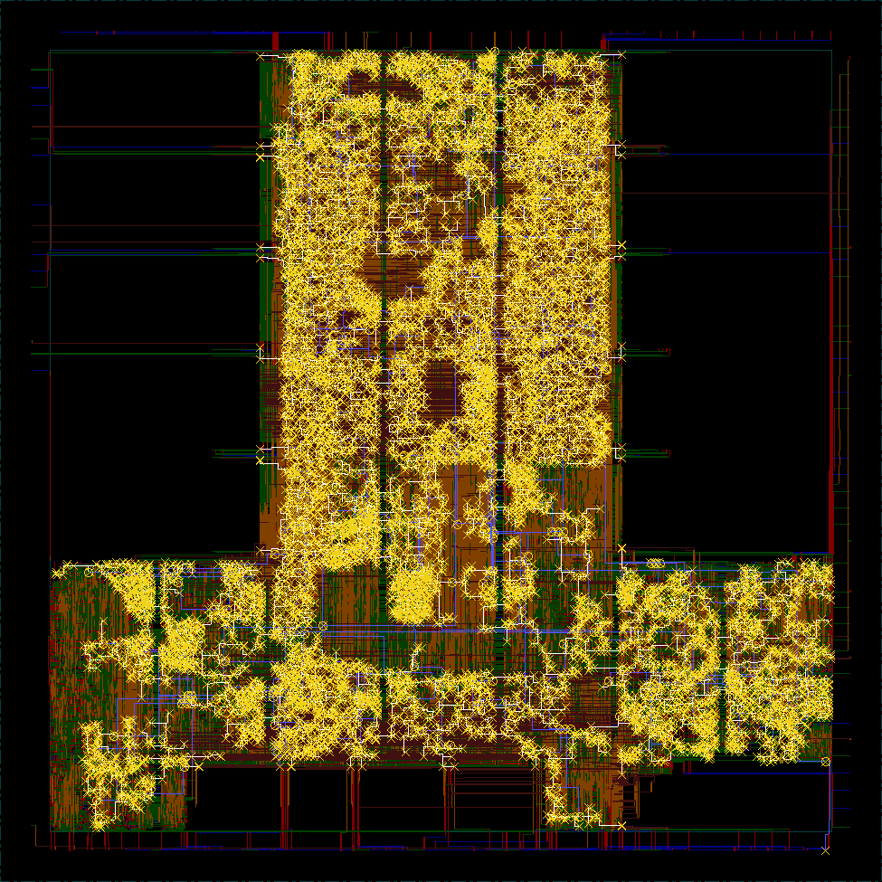

Slide 77
Now
Perform Timing Analysis
Perform power analysis
Stream out!

Slide 78
Demo
Synthesis & P&R

Slide 79
Synopsys PrimePower
Power Estimation

Slide 80
Power Estimation
Level of Abstraction
RTL
Synopsys PowerCompiler, PowerEstimator
Gate
Synopsys PrimePower, Power Compiler
Circuit
Synopsys HSIM/ Nanosim
Polygon (we don’t support it)
Synopsys RailMill/ Arcadia

Slide 81
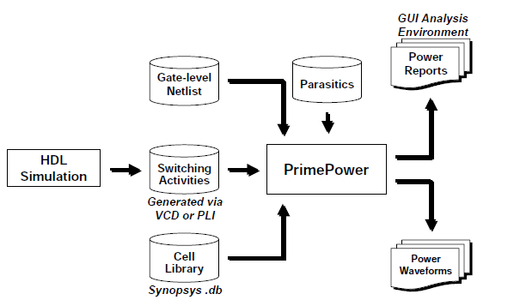
PrimePower flow

Slide 82
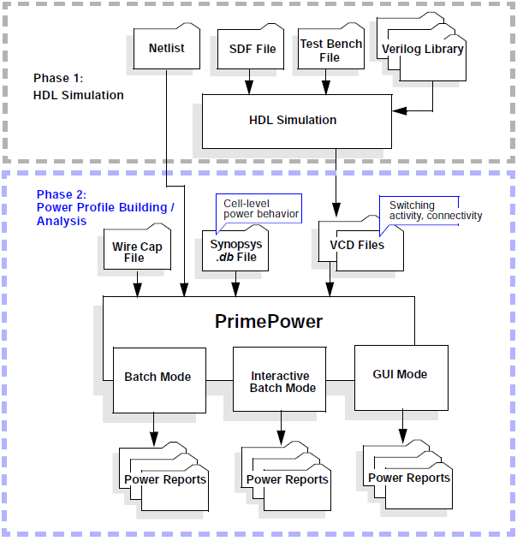

Slide 83
PrimePower
Runs at Gate Level ( -> you need to synthesize)
Have 2 phase
Phase 1: dumping switching activity
Phase 2: Calculating Power
Can show peak & instance power.

Slide 84
Phase 1
Calculate switching activity & dump it in VCD
Modern simulator supports this directly
For example, In ModelSim
Vsim> vcd file test.vcd
Vsim> vcd add –r /testbench/core/*
Vsim > run –all
Be carefull!
VCD files can take huge space.
What to annotate? Only inputs, or all nodes?

Slide 85
SideNote!
In our flow, v1.2 there is an incompatibility between PrimePower 2003 & ModelSim 6.5
PrimePower cannot read-in ModeSim’s VCD file
Use VCD2WLF & then WLF2VCD tool to fix VCD file.
Refer to flow’s userguide for detailed info.

Slide 86
Phase 2
In PP, first read in the design
set search_path {.}
set link_library {osu025_stdcells.db}
read_verilog {aes_post_layout.v}
current_design aes_cipher_top
create_clock -period 2 clk
Link
Switching Activity Annotation:
read_vcd -strip_path test/u0 aes.vcd
Back Annotation for performing after-layout estimation
read_parasitics aes.spef
set_waveform_options -interval 1 -file primepower -format fsdb
Report!
calculate_power -waveform
report_power -file primepower -threshold 0 -sortby power

Slide 87
PrimePower reports
Contains
Total Power (Dynamic + Leakage)
Dynamic Power ( Switching + Internal )
Switching Power (load capacitance charge or discharge power )
Internal Power ( power dissipated within a cell )
X-tran Power ( component of dynamic power-dissipated into x-transitions )
Glitch Power ( component of dynamic power-dissipated into detectable glitches at the nets )
Leakage Power ( reverse-biased junction leakage + subthreshold leakage )

Slide 88
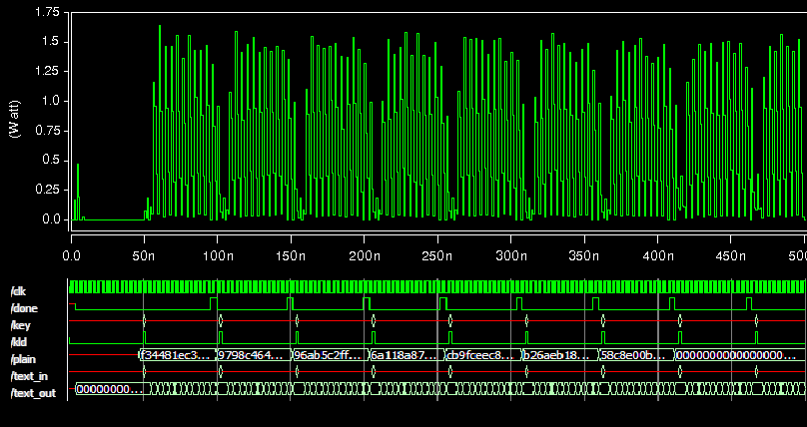
FSDB output

Slide 89
Synopsys HSIM
Circuit level simulation & co-simulation
Post-Layout verification

Slide 90
Synopsys HSIM
Hierarchical Storage and Isomorphic Matching
It’s Spice, then
AC analyses
DC analyses
Transient analyses
Monte Carlo analyses
FFT analyses
Sister tools: CRITIC, HANEX
Not supported by synopsys anymore.

Slide 91
Synopsys HSIM
First developed by Nassda
Fast SPICE, means it’s event based.
1,000-10,000x faster than SPICE with user-selectable accuracy
Hierarchical storage and simulation
Isomorphic matching: duplicate simulated circuit response for isomorphic subcircuits under same conditions.
Does not use simplified model or simulation algorithms.
Similar fast-spice: Synopsys Star-SimXT, Synopsys NanoSim, Cadence Spectre, UltraSim, ATS

Slide 92
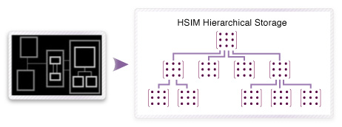
Hierarchical Storage
Traditional SPICE
Flatten design
simultaneously solve for all node voltages and branch currents
HSIM:
hierarchical design
partitioning the simulation database into a set of smaller matrices that can be solved independently
increasing performance
reducing memory

Slide 93
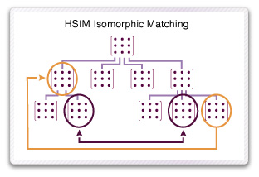
Isomorphic Matching
dynamically recognizing multiple instances of identical cells
solving each cell just once for all isomorphically matched instances
Special case
large memory blocks with many identical bit cells.

Slide 94
input
HSPICE including triple DES (3DES) and Verilog-A encryption
Spectre and Eldo-format netlists
VCD and HSPICE vector stimulus
Interpreted and compiled Verilog-A
DPF, SPEF, and DSPF parasitic formats

Slide 95
output
ASCII .out and raw formats
WSF, PSF, PSF-float
WDF
FSDB
UTF
.measure, built-in timing and power checks

Slide 96
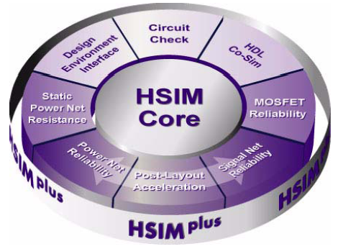
HSIM structure

Slide 97
Applications
Full-chip pre & post layout verification
High-speed circuit simulation for memory circuits
DRAM, SRAM, ROM, EPROM, EEPROM, Flash memory
Timing and power characterization
Cross-talk noise simulation
High-speed analog and mixed-signal circuit simulation
Functionality, timing, and power analysis report
power net IR drop, coupling capacitance

Slide 98
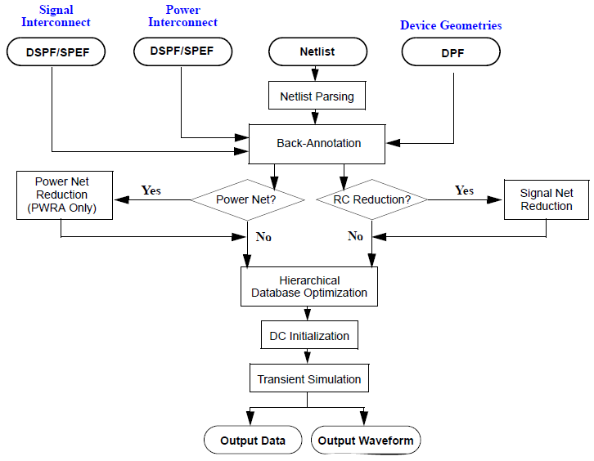
simulation flow

Slide 99
Accuracy Options in HSIM
Can individually set for each subcircuit or instance:
.param subckt=pll inst=Xpll HSIMparam=<value>
HSIMSPEED: choose speed-up mechanisms
 0 (accurate) ~ 6 (fast) (see the manual).
HSIMSPICE: model accuracy
 0 (table model), 1 (DC model), 2 (AC model).
HSIMANALOG: coupling between subcircuits
 0 (no coupling), 1 (coupling within hierarchical boundary), 2 (coupling across the boundary).

Slide 100
Input Vector
Using vec file for input
Spice deck:
.param HSIMVECTORFILE = ‘hsim.vec’
Vector file (hsim.vec):
signal clk pd_out[1:0] phdir phwt_0 phwt_14
+ phsel_up phsel_dn phwt_up phwt_dn toggle_dir
period 10
radix 111111 11111
io iiiiii ooooo
110111 00000
010111 00000
110111 00000
………
Using verilog testbenches as input
Requires co-simulation of Verilog-Spice code

Slide 101
Case studies
Post-layout back-annotation
Mixed-Signal Simulation
Verilog-A support
V2S
Timing & Power Analysis

Slide 102
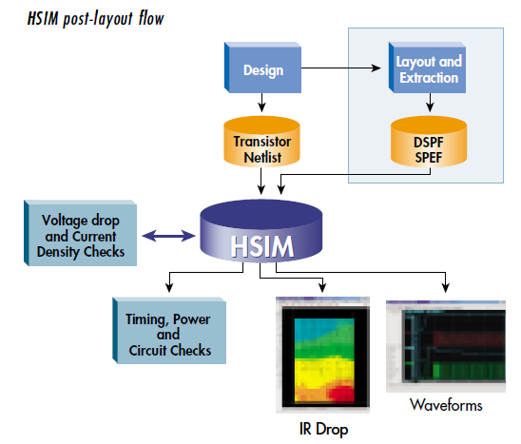
Case studies

Slide 103
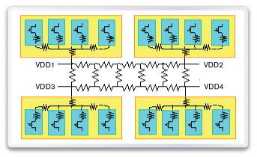
Post-layout back-annotation
Device back-annotation
From post-layout DPF ( flat )
RC back-annotation
DSPF/SPEF netlists ( resistors & capacitors )
Selective annotation
Back-annotating
Power net
Clock net
Signal net

Slide 104
Verilog-A support
Analog Enhancement to Verilog.
Good for describing a behavioral model of devices.
I’ve the models of following devices:
BSIM3v3, BSIM4, EKV, HISIM, Level3, BJT, MEXTRAN, VBIC, TFT, fbh_hbt, Hicum, JFET

Slide 105
Verilog-A support / example
module qam_mod( mout, din, clk);
inout mout, din, clk;
electrical mout, din, clk;
parameter real fc = 100.0e6;
electrical di1,di2, dq1, dq2;
electrical ai, aq;
serin_parout sipo( di1,di2,dq1,dq2,din,clk);
d2a d2ai(ai, di1,di2,clk);
d2a d2aq(aq, dq1,dq2,clk);
real phase;
analog begin
phase = 2.0 * `M_PI * fc* $realtime() + `M_PI_4;
V(mout) <+ 0.5 * (V(ai) * cos(phase) + V(aq) * sin (phase));
end
endmodule

Slide 106
Converters
v2s:
a tools that converts synthesized or structured verilog netlist to spice equivalent.
Can convert based on given gate models and standard cells.
Requirement:
Process Transistor Model .model
Standard Cell Spice Library
v2s aes_post_layout.v -s osu025_stdcells.sp -const0 0 -const1 2.5 -o aes.sp
Waveform conversion

Slide 107
Timing & Power Analysis
.tcheck & .pcheck commands
timing checking
setup, hold, pulse width, edge, checking windows, bisection optimization
.tcheck check1 setup D x ck r 100ps
power analyses
DC path, excessive current, excessive rise/fall, high impedance node
.pcheck check2 exrf Q rise=200ps fall=200ps
.acheck : node activity check

Slide 108
Other features not covered here
Post-Layout Acceleration Option (PLX)
Power Net Reliability Analysis Option (PWRA)
Static Power Net Resistance Calculation Option (SPRES)
Signal Net Reliability Analysis Option (SIGRA)
MOS Reliability Option (MOSRA)

Slide 109
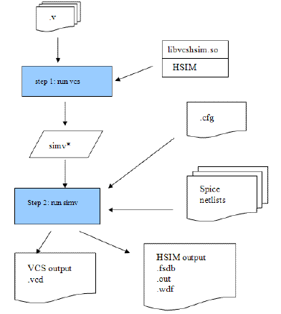
Mixed-Signal Simulation
can connect to other HDL Simulator
( ModelSim, VCS, NC-Verilog, … )
through Verilog-PLI 2.0, VPI
They run through a unified process,
hence more speed.
It puts a2d , d2a call on ports.
requires a hsimvpi library,
I only found it for linux platform.
To modes:
Spice-top
Verilog-top

Slide 110
Co-Simulation
Based on ModelSim/HSIM
Interactions are based on Verilog-PLI
Requires libhsimvpi (for linux/x86)
Flow:
Convert post-layout verilog netlist to spice netlist
V2s layout.v -s lib_stdcells.sp -const0 0 -const1 2.5 -o layout.sp
Create a power network (hsim doesn’t do this by default )
you need a power-network generator for post-layout spice netlist.
Embed the SPEF file in it!
.param HSIMSPEF=huffman.spef
Put it all together and run it!

Slide 111
Co-Simulation
.param HSIMSPEF=huffman.spef
.subckt huffman clk reset enable load input[3] input[2] input[1]
+ input[0] output[3] output[2] output[1] output[0] valid
XU1480 N209 vdd N198 add_80/carry[5] gnd XOR2X1
XU1479 gnd vdd n1229 n1228 N1189 n1227 AOI21X1
XU1478 gnd vdd freq[15][4] n1225 n1228 n1224 OAI21X1
...
.ends huffman
module huffman (
clk,
reset,
enable,
load,
\input ,
\output ,
valid);
input clk;
input reset;
input enable;
input load;
input [3:0] \input ;
output [3:0] \output ;
output valid;
initial $nsda_module();
endmodule
.hsimparam HSIMTIMESCALE=100
.param hsimspeed=5
*.hsimparam HSIMALLOWEDDV=5.0
.param VDDVAL=3v
* global nodes
.global vdd vss gnd
* supplies
vvdd vdd 0 dc VDDVAL
vgnd gnd 0 dc 0v
.inc tsmc025.m
.inc osu025_stdcells.sp
.inc huffman.sp
.print v(*)
.end
vsim -pli /opt/hsim/hsimplus/platform/linux/bin/libvpihsim.so work.Testbench

Slide 112
Simulation output
The HDL part output is visible in ModelSim.
For the analog part, Hsim produces the FSDB file format
To view it
Use Synopsys CosmosScope (part of Saber)
Use Novas Debussy

Slide 113
Sample HSIM flow

Slide 114
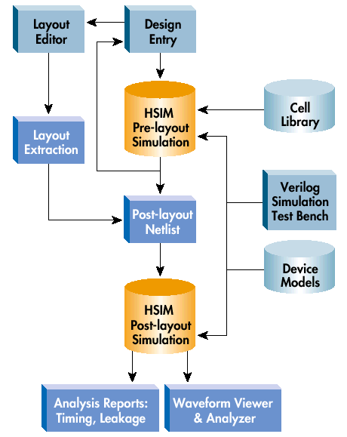
Silicon Access Networks
20Gbps iFlow Chipset
0.13u TSMC analog/mixed signal designs
GHz Ser/Des plus many analog blocks (e.g. PLLs) and megabytes of memory
HSIM-based verification methodology allowed Silicon Access to…
Perform critical analog simulations - PLL power up, synchronization operations, and jitter, and SerDes clock recovery
Reduce standby power through leakage checks
Have a post-layout timing simulator for all circuits

Slide 115

Accelerant Networks
10Gbps Network Transceiver
130K-transistor analog/mixed signal design, .25u TSMC
Many Analog Blocks (PLL, DLL, A/D, etc.)
Several Thousand Cycles of simulation required for each block
Existing simulation solution would have taken weeks (if it completed at all)
HSIM-based verification methodology allowed Accelerant Networks to…
Verify critical timing performance (PLL settling, clock skew, etc.)
Simulate 8uS of Full Chip performance
Verify post-layout extracted RLC
Drop a cumbersome mixed-mode approach (Verilog/Spice)

Slide 116

Sharif Dependable System Lab [DSL]
HSIM were used as part of fault injection flow to evaluate reliability of a processor design
Mixed-signal simulation at three-level of abstraction
Fault is injected in Verilog-A module, attached to Spice netlist using external circuit (X).

Slide 117
Sharif Dependable System Lab [DSL]

Slide 118
Sharif Dependable System Lab [DSL]
With HSIM
We get an accurate simulation of fault, near the fault site.
Fault injection on memory modules (SRAM, DRAM, …) is very fast.
The rest of the design is simulated in ModelSim
Speed penalty for fault injection is very low.
Fault Injection on Analog modules or modules that doesn’t have HDL description. ( robust SRAM, DRAMs, delayed Latches, PLLs, etc. )
Behavioral fault injection in Verilog-A
We can explore various fault models.
Currently we support : SET/SEU, EMI, PSD, Temp. Variation.

Slide 119
Tool demonstration

Slide 120

Summary of the Design Flow

Slide 121
High-Speed Digital Design
checklist

Slide 122
RTL techniques
yield far greater benefits than anything done in synthesis or P&R
Modules should contain only functions that are physically close (e.g. don’t put a red and black I/O DMA in the same state machine)
All outputs of a Module should be registered.
Registered outputs of Modules should not have feedback paths. (e.g. no feedback mux; verify in synthesis RTL view)
Modules should register inputs before use.
Modules should use two way handshakes for command, busy, ready signals to allow multiple delay cycles between them.
This allows adding additional input registers to a module in case it’s routing across a large chip. (reduces strain on constraints elsewhere)

Slide 123
RTL techniques
6. Reduce number of default assignments in State-Machine states; E.g only reset a register during IDLE if it is really needed. (Fewer assignments keep logic decode and muxing levels to a minimum)
7. Try a different State-Machine encoding (Usually one-hot is fastest, but not always due to fan-out on very large state-machines)
8. There shall be no internal bidirectional tri-state busses. (tri-states may be used to reduce large muxes)
9. Design memory interfaces such that pipelined operations are supported. This allows bursting reads/write with multiple register stages, to include registers packed in the I/O Blocks.
10. Use as few clock domains as possible. (reduces timing constraint effort)

Slide 124
RTL techniques
11. Use only 1 edge of the clock internally; prefer rising_edge. (not all clock distribution guarantees 50/50 duty cycle, so crossing clock edges cuts your Fmax in ½ - dutyCycleError)
12. Duplicate registers in RTL if you know during design that a register will drive (This allows you to force synthesis via directives to keep the paths separate, but not disable global resource sharing, which may improve timing)
multiple I/O
many loads,
physically separate modules
13. Increase I/O drive speed to help with clock->out (Only if your board design/parts can handle this! Consider Signal integrity + SSO issues)
14. Use only global clock input buffers and dedicated routing. (Make sure the board layout is routing 0-skew clocks between multiple devices)
15. Consider mapping large combinatorial functions into look up tables. (make sure you register the output to allow implementation into a Block RAM; dual-port memories allow 2 such look up tables to work independently in 1 Block RAM. E.g. AES S-box function)
16. Instantiate device specific IP blocks for common functions as they are usually more optimized than RTL inferred ones. Additionally they are usually floor-planned for better layout/routing. E.g. instantiate IP blocks for large counters, multipliers, adders, muxes etc. (Make sure to comment the IP functions well to identify latency and function requirements for future re-use)

Slide 125
Synthesis techniques (FPGA)
Disable resource sharing. (generally decreasing sharing improves performance; the exception is if you are resource limited then this may decrease performance)
Adjust global fan-out limit. (generally set this very large 1K+ and let the FPGA vendor tools handle fan-out buffering)
Decrease local fan-out limit on nets that have known timing issues. (see RTL:12)
Apply Synplify directives to prevent register pruning on RTL instantiated duplicate registers (see RTL:12). (Using the scope file + RTL view makes this easy)
Input all constraints in Synplify constraint file. It uses this to determine where to make optimizations.
Specify false clock -> clock paths between true asynchronous/separate clock domains.
Identify paths with low slack (or none) and look at the path in the technology view. Understanding how your RTL is being mapped to the device specific resources (LUTs/cCells) will help you understand how to change your RTL for better performance.

Slide 126
Mapping and Place & Route: P&R
Identify physical routes that are causing timing issues: (go back to RTL:1)
Floor-plan using RLOC constraints if possible.
Tightly Floor-plan modules that are not having timing issues. Over-packing a module that easily meets timing allows more resources for other modules.
In a large device with low resource utilization, consider floor-planning a module to a tighter grouping; sometimes the tools can’t handle too much freedom and produce a slower result.
Understand the devices physical layout; especially of hard IP blocks (Ram, processors, multipliers etc). Modules that cross hard IP boundaries may experience a routing penalty; try to avoid this in floor-plans. E.g crossing a dedicated Block Ram column in a Virtex series adds routing delay.
Increase effort levels of mapper & P&R.
Run multiple random starting seeds through P&R.

Slide 127
Clock, Power and Thermal issues
Use the fastest clock input and source available. E.g. LVDS or LVPECL clock sources and inputs reduces skew, and also reduce internal device power due to decreased switching rates in CMOS.
If you can guarantee your devices maximum operating temperature and it is less than the device maximum then consider the following to reduce device power and temperature. This allows you to pro-rate the device speed grade at a lower temperature, increasing the effective speed of the device.
Implement power management (clock gating, or clock speed scaling).
Increase active cooling on chip (heat sinks, fans, Peltier cooler [TEKs])
Increase voltage regulation (within device guidelines). Device timing defaults to assume worst case voltage regulation. Increasing this increases speed but also power which may actually counteract this (See Other various:1)

Slide 128

Thank you!
Questions?

